Slide 1
第6-5章 Variable Selection
部分Slides参考
Tibshirani: www-stat.stanford.edu/~tibs/ftp/lassotalk.pdf‎
Chapter 3 of Hastie, Tibshirani and Friedman: Elementary of Statistical Learning
Chapter2 of Buhlmann, Statistics for high-dimensional data

Slide 2
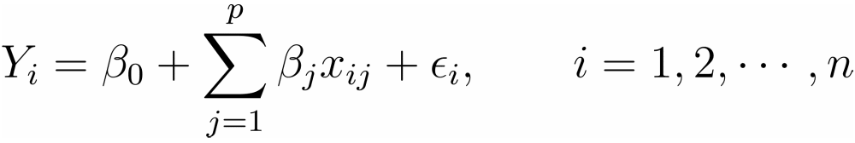


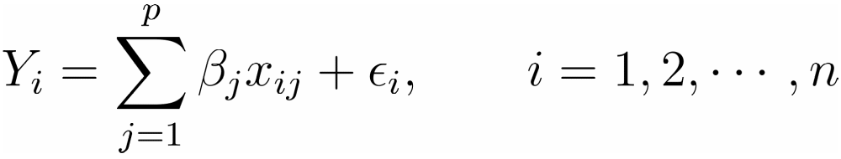
从线性回归谈起
令
其中
如果将Y和X_{j}去中心化，则截距项 于是模型可以简化为

Slide 3
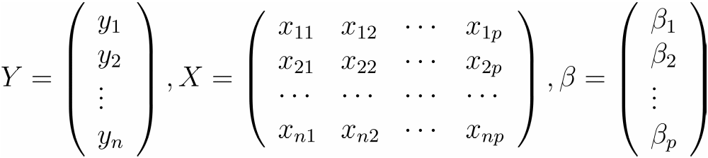
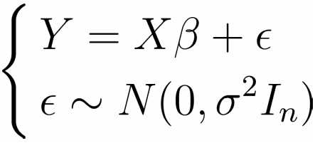
从线性回归谈起
记
其中X称之为设计矩阵，于是有

Slide 4



回归的含义
给定数据 我们希望得到协变量X和响应变量Y的函数关系
另一个含义：如果把变量X,Y都看成随机变量，而把数据看成随机变量的实现, 那么m(x)就是X=x下Y的期望, 即
于是回归的目的就是对函数m(x)进行估计

Slide 5
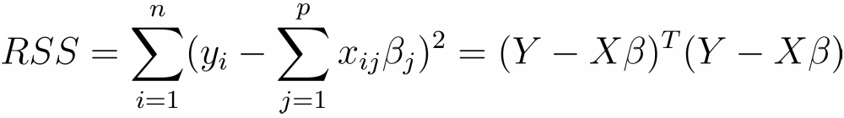
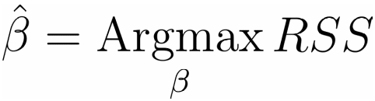
最小二乘估计
定义残差平方和
那么最小二乘估计

Slide 6
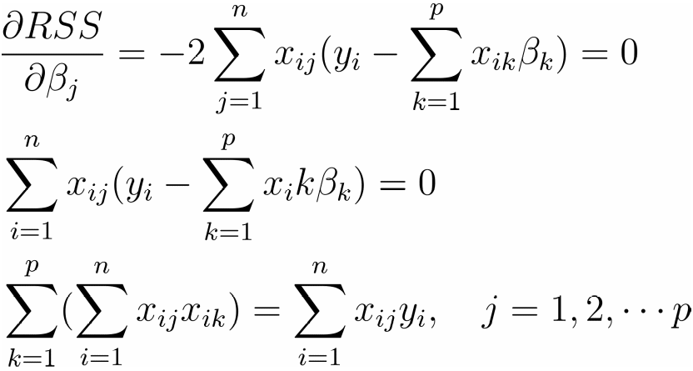

最小二乘求解
求导
写成矩阵形式即

Slide 7

最小二乘解
如果矩阵X^{T}X可逆，则
那么回归函数

Slide 8


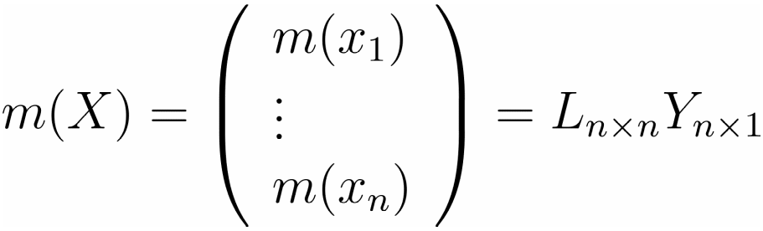
帽子矩阵
定义帽子矩阵
L满足
那么

Slide 9


最小二乘估计的统计性质
无偏性(Unbiased)
方差(条件：ε_{i} i.i.d, Var(ε)=σ²I_{n})
故

Slide 10
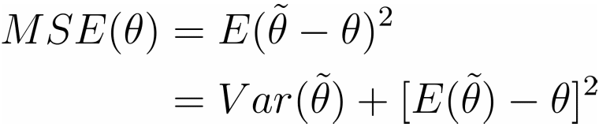
Gauss-Markov定理
Gauss-Markov定理：所有线性无偏估计中，参数β的最小二乘估计具有最小方差。
考虑参数估计的均方误差
估计的均方误差和预测误差相关
一种可能性：有偏的估计可能具有更小的均方误差

Slide 11
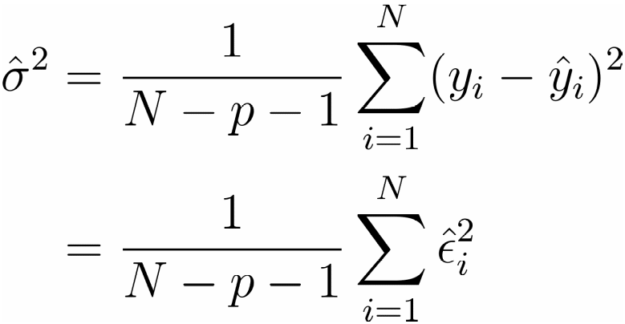
最小二乘估计的统计性质
方差的无偏估计
这里自由度减少了p+1个是因为估计了p个回归系数，加上中心化又减少了一个自由度。

Slide 12
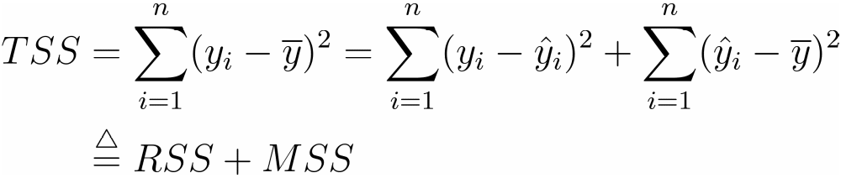
平方和分解
平方和分解
其中TSS总偏差平方和; RSS残差平方和(由随机误差引起); MSS回归平方和(由回归的好坏决定);

Slide 13
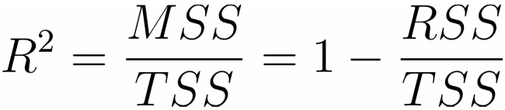
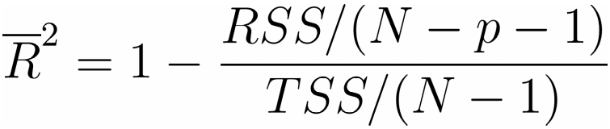
回归的评价--判定系数
R²
自由度调整R²

Slide 14
回归方程的检验
检验问题
如果随机误差满足： , 则在H₀下

Slide 15
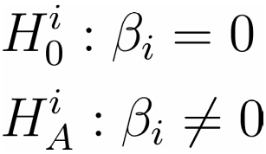

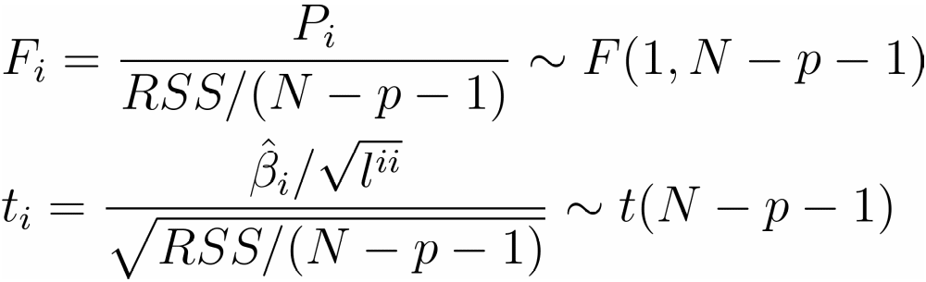
回归系数的检验
检验问题
如果随机误差满足： , 则在H^{i}₀下

Slide 16




回归系数的检验
其中分子是偏回归平方和，是全部变量的回归平方和与去掉第i个变量之后的回归平方和的差
可以证明
其中 为L的逆的第i个对角元素。

Slide 17
Variable Selection Problem
A common problem is that there is a large set of candidate predictor variables.
Goal is to choose a small subset from the larger set so that the resulting regression model is simple, yet have good predictive ability.

Slide 18
Two basic Methods of Selecting Predictors
Stepwise regression: Enter and remove predictors, in a stepwise manner, until there is no justifiable reason to enter or remove more.
Best subsets regression: Select the subset of predictors that do the best at meeting some well-defined objective criterion.

Slide 19
Stepwise Regression: the Idea
Start with no predictors in the “stepwise model.”
At each step, enter or remove a predictor based on partial F-tests (that is, the t-tests).
Stop when no more predictors can be justifiably entered or removed from the stepwise model.

Slide 20
Drawbacks of Stepwise Regression
The final model is not guaranteed to be optimal in any specified sense.
The procedure yields a single final model, although in practice there are often several equally good models.
It doesn’t take into account a researcher’s knowledge about the predictors.

Slide 21
Stepwise Regression Methods
Three broad categories:
  Forward selection
  Backward elimination
  Stepwise regression

Slide 22

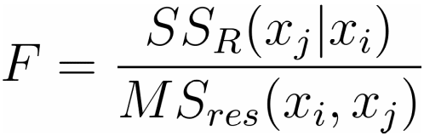
Forward Selection
Start the model with intercept term only
Add one regressor with largest F value for testing significance of candidate regressor with
Chose a regressor with largest partial F-statistic,
If F>F_{IN}, then x2 is added.
Procedure terminates either when the partial F-stastic at a particular step does not exceed F_{IN} or when the last candidate regressor is added.

Slide 23
Backward Elimination
  Start with a model with all K candidate regressors.
The partial F-statistic is computed for each regressor, and drop a regressor which has the smallest F-statistic and < F_{OUT}.
Stop when all partial F-statistics > F_{OUT}.

Slide 24
Stepwise Regression
A modification of forward selection.
A regressor added at an earlier step may be redundant. Hence this variable should be dropped from the model.
Two cutoff values: F_{OUT} and F_{IN}
Usually choose F_{IN} > F_{OUT} : more difficult to add a regressor than to delete one.

Slide 25
Stepwise Regression
A modification of forward selection.
A regressor added at an earlier step may be redundant. Hence this variable should be dropped from the model.
Two cutoff values: F_{OUT} and F_{IN}
Usually choose F_{IN} > F_{OUT} : more difficult to add a regressor than to delete one.

Slide 26
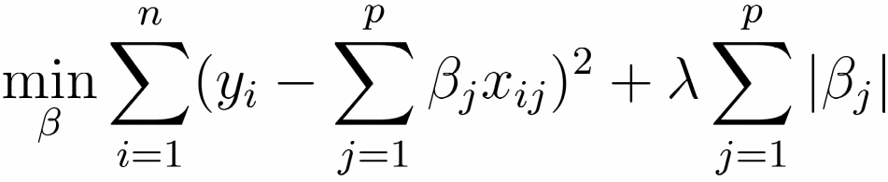
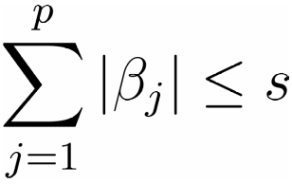
Lasso Model
Lasso: Least Absolute
Minimize
Equivalent to minimizing sum of squares with constraint (Lagarangian function)

Slide 27
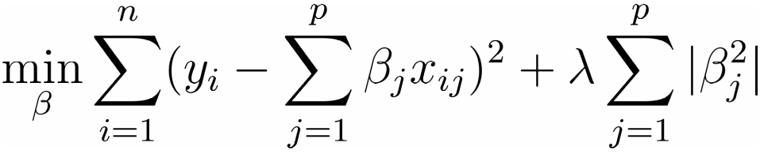
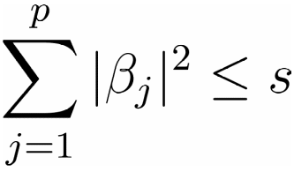

Ridge Regression
Minimize
Equivalent to minimizing sum of squares with constraint
Close-form solution

Slide 28
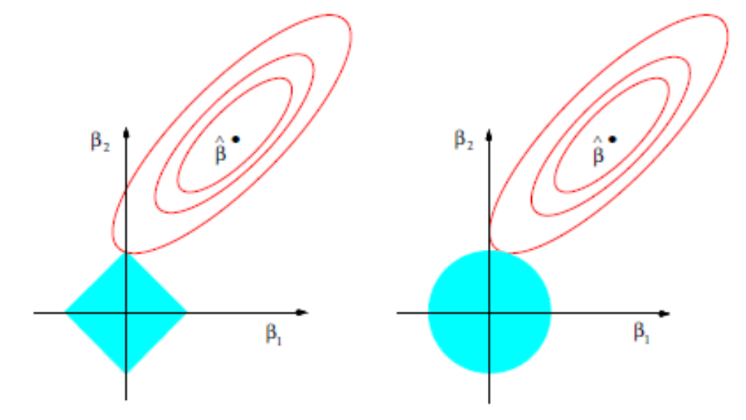
Picture of Lasso and Ridge Regression

Slide 29

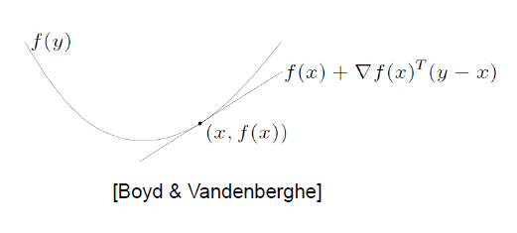

次梯度(Subgradient)
设凸函数 是R^{n}上的凸集, 如果函数在x₀点不可微，则满足
这里 是梯度
http://select.cs.cmu.edu/class/10725-S10/recitations/r7/Subgradients.pdf

Slide 30

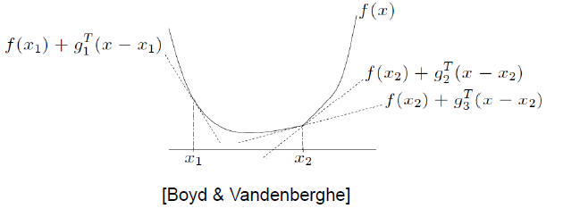
次梯度(Subgradient)
设凸函数 是R^{n}上的凸集, 如果函数在x₀点不可微，如果存在向量g, 使得
则称向量g为x₀处的次梯度。
http://select.cs.cmu.edu/class/10725-S10/recitations/r7/Subgradients.pdf

Slide 31

次微分
对于一个给定的点，可能不止一个这样的次梯度存在，而是一个次梯度集合，这样的集合称为次微分，记为
http://select.cs.cmu.edu/class/10725-S10/recitations/r7/Subgradients.pdf

Slide 32

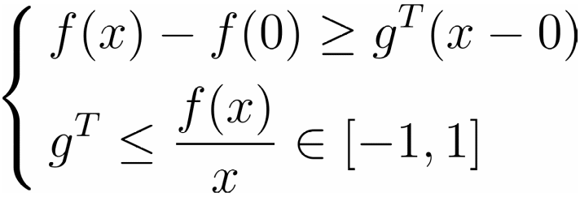
次微分例子
例：
在0点处不可微，由次梯度的定义
http://select.cs.cmu.edu/class/10725-S10/recitations/r7/Subgradients.pdf

Slide 33



次微分性质
可加性:
伸缩性:
仿射变换:
链锁法则:

Slide 34
次微分和优化
如果f是可微的凸函数
如果f是不可微的凸函数

Slide 35
Algorithms for Lasso
Standard convex optimizer
Least angle regression (LAR) - Efron et al 2004- computes
Entire path of solutions. State-of-the-Art until 2008
Pathwise coordinate descent---New

Slide 36


Pathwise Coordinate Descent for the Lasso
Coordinate descent: optimize one parameter (coordinate) at a time.
How? suppose we had only one predictor. Solution is the soft-thresholded estimate
where is usual least squares estimate.
Idea: with multiple predictors, cycle through each predictor in turn. We compute residuals and applying univariate soft-thresholding.

Slide 37
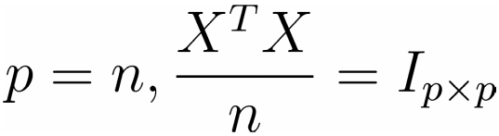
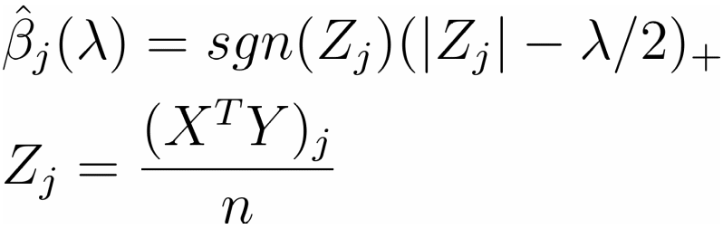
Orthonormal Design
Orthonormal design
Then the lasso estimator is the soft-thresholding estimator
Where (x)₊=max(x,0).

Slide 38
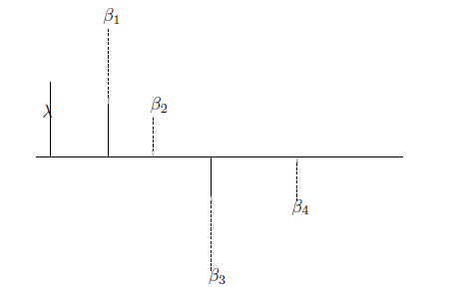
Soft-Thresholding

Slide 39
Pathwise Coordinate Descent for the Lasso
Start with large value for λ (very sparse model) and slowly decrease it
Most coordinates that are zero never become non-zero
Coordinate descent code for Lasso is just 73 lines of Fortran!

Slide 40
Extension
Pathwise coordinate descent can be generalized to many other models: logistic/multinomial for classification, graphical lasso for undirected graphs, fused lasso for signals.
Its speed and simplicity are quite remarkable.
glmnet R package now available on CRAN

